Slide 1

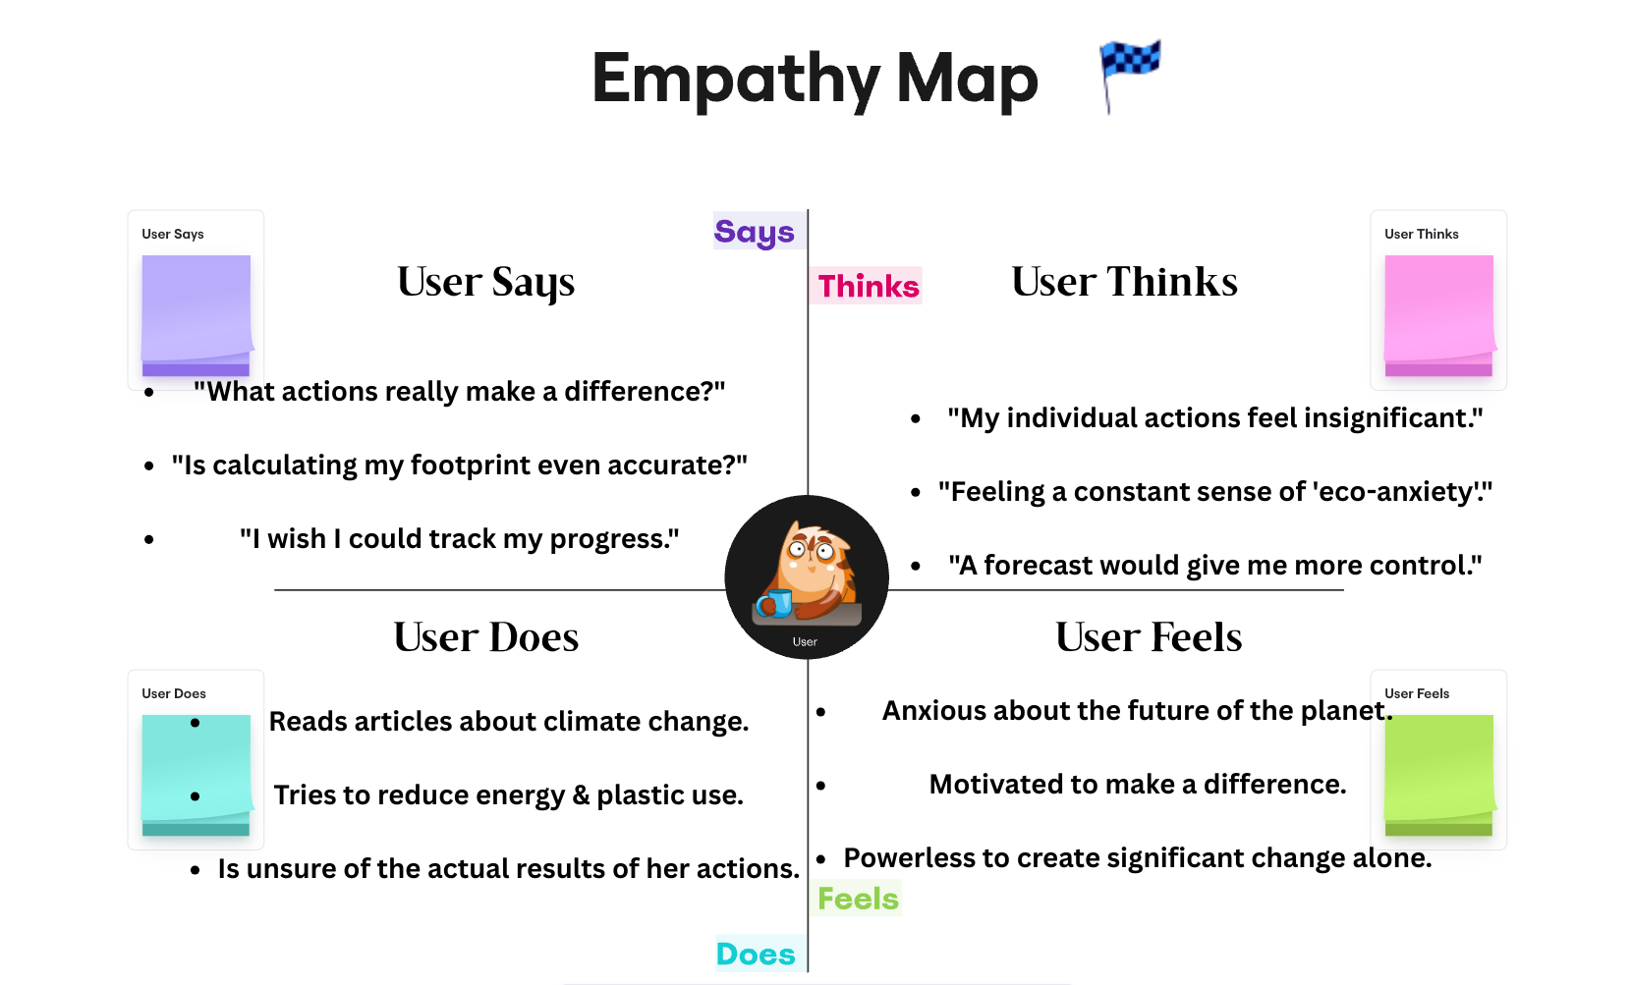
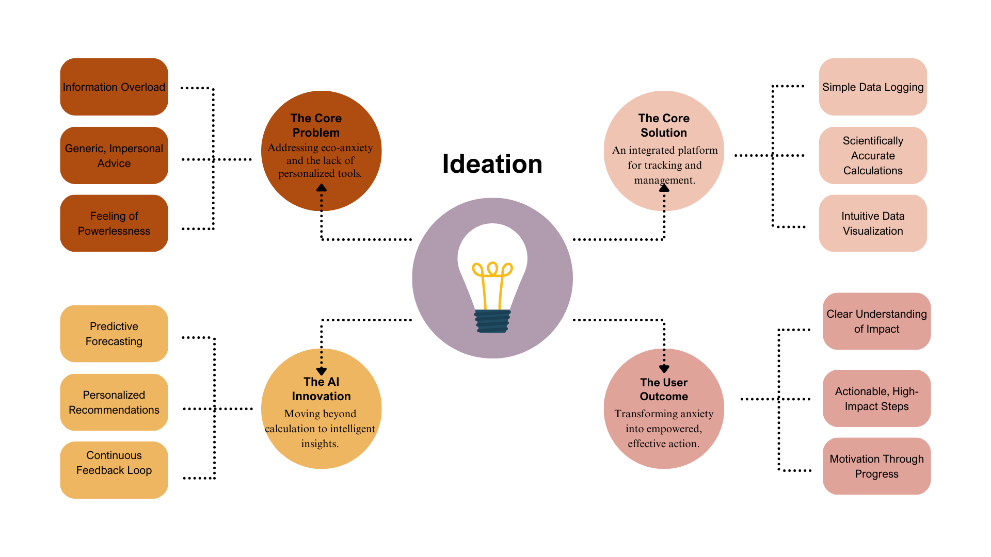
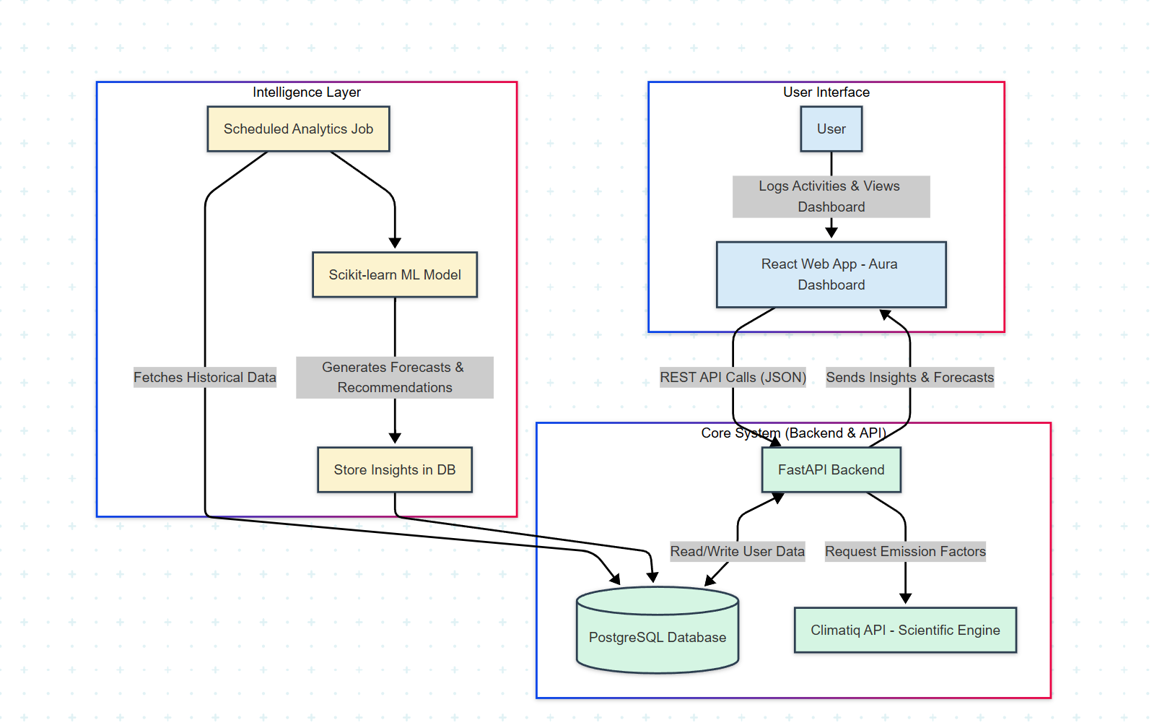
MIT SCHOOL OF COMPUTING
Class : LY
Group ID: LYIT14
DEPARTMENT OF Information Technology
Aura: AI Based Personal Carbon Footprint Prediction Platform
Tushar Lalwani,Omkar Rasal and Neil Shah
Faculty Guide:
Prof. Rupali Bhatkhande
Proposed Block Diagram:
Problem Statement:-
Proposed Solution:-
Future Scope:-
The Problem of Personalization: Existing carbon footprint calculators are generic, failing to provide advice tailored to a user's specific lifestyle and habits.
The Problem of Engagement: Current tools are static, offering no way to track progress over time, which makes it difficult to stay motivated and see the results of one's efforts.
A personalized dashboard to accurately calculate an individual's carbon footprint using a live, scientific API for emission factors.
Progress tracking and data visualization through simple charts and graphs to monitor trends and the results of positive changes over time.
An AI-powered forecasting engine to predict future emissions and provide personalized, high-impact recommendations for reduction
Expand the calculator to include more lifestyle categories, such as different home energy sources and personal waste recycling, for a more complete footprint analysis.
Introduce automated tracking by securely connecting with other apps (like travel or utility services) to reduce manual data entry for the user.

